Slide 1
Implementing Lattice-Based Cryptography on Embedded Devices
Summer school on real-world crypto and privacy

Slide 2
Outline
Motivation
Ring-learning with errors (RLWE)
Public-key encryption based on RLWE
Area-optimized implementation
High-performance implementation

Slide 3
Outline
Motivation
Ring-learning with errors (RLWE)
Public-key encryption based on RLWE
Area-optimized implementation
High-performance implementation

Slide 4
Why Implementation of Lattices?
Why focus on lattice-based cryptography?
We can get signatures and public key encryption out of lattices and also more (IBE, FHE)
A lot of development on theory side; schemes are getting better and better
Implementation of lattices is a young field; only done for 3-4 years now (except for NTRU)

Slide 5
Implementation
Conditions that have to be met for implementation
Parameters, parameters, parameters
Security level should be known
What are the goals?
Throughput, latency, and power/energy
Code size/area (drives costs)
Small key, ciphertext, and signature size
Cross-disciplinary work and interaction between engineers and cryptographers required
Parameter selection and design decisions can make schemes more efficient but also weaker

Slide 6
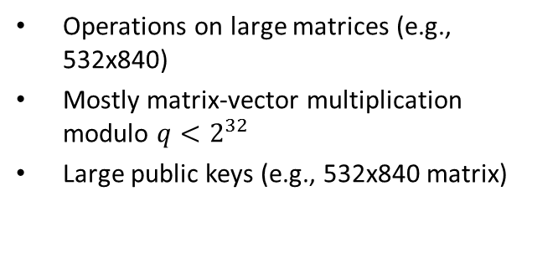
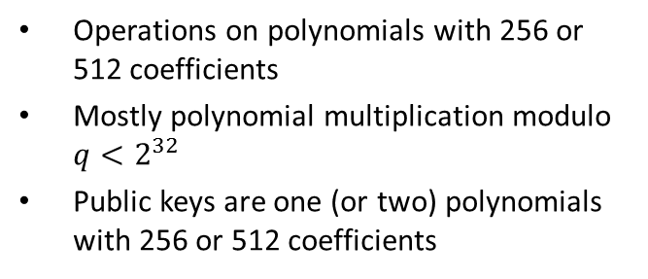
To be Ideal or not Ideal?
Two important lines of research: random lattices and ideal lattices
Big impact on implementation (theory not that much)
Security for random lattices is better understood (ideal lattices are more structured)
Random Lattices
Ideal Lattices
Operations on large matrices (e.g., 532x840)
Mostly matrix-vector multiplication modulo $q<2^{32}$
Large public keys (e.g., 532x840 matrix)
Operations on polynomials with 256 or 512 coefficients
Mostly polynomial multiplication modulo $q<2^{32}$
Public keys are one (or two) polynomials with 256 or 512 coefficients
Implementation of random lattice signatures: High-speed signatures from standard lattices, Özgür Dagdelen, Rachid El Bansarkhani, Florian Göpfert, Tim Güneysu, Tobias Oder, Thomas Pöppelmann, Ana Helena Sánchez, Peter Schwabe, Latincrypt’14

Slide 7
Outline
Motivation
Ring-learning with errors (RLWE)
Public-key encryption based on RLWE
Area-optimized implementation
High-performance implementation

Slide 8





Learning with Errors
Solving of a system of linear equations
secret
$$ℤ_{13}^{7×4}$$
$$ℤ_{13}^{4×1}$$
$$ℤ_{13}^{7×1}$$
4 | 1 | 11 | 10
5 | 5 | 9 | 53
3 | 9 | 0 | 10
1 | 3 | 3 | 2
12 | 7 | 3 | 4
6 | 5 | 11 | 4
3 | 3 | 5 | 0
6
9
11
11
4
8
1
10
4
12
9
$$×$$
$$=$$
Use Gaussian elimination
Blue is given; Find (learn) red => Solve linear system
(slides stolen from talk by Douglas Stebila at RWC’15)

Slide 9


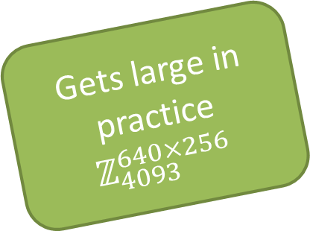
Learning with Errors
Solving of a system of linear equations
random
secret
small noise
looks random
$$ℤ_{13}^{7×4}$$
$$ℤ_{13}^{4×1}$$
$$ℤ_{13}^{7×1}$$
$$ℤ_{13}^{7×1}$$
4 | 1 | 11 | 10
5 | 5 | 9 | 53
3 | 9 | 0 | 10
1 | 3 | 3 | 2
12 | 7 | 3 | 4
6 | 5 | 11 | 4
3 | 3 | 5 | 0
6
9
11
11
0
-1
1
1
1
0
-1
4
8
1
10
4
12
9
$$×$$
$$+$$
$$=$$
Gets large in practice
$$ℤ_{4093}^{640×256}$$
Blue is given; Find red => Learning with errors
(slides stolen from talk by Douglas Stebila at RWC’15)

Slide 10
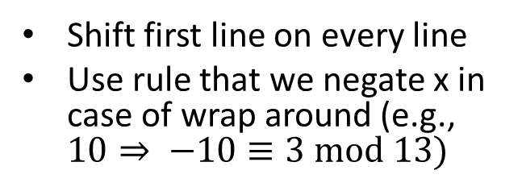

(Ring) Learning with Errors
From learning with errors to ring-learning with errors
$$ℤ_{13}^{7×4}$$
4 | 1 | 11 | 10
3 | 4 | 1 | 11
2 | 3 | 4 | 1
12 | 2 | 3 | 4
9 | 12 | 2 | 3
10 | 9 | 12 | 2
11 | 10 | 9 | 12
Only one line has to be stored
4 | 1 | 11 | 10
Shift first line on every line
Use rule that we negate x in case of wrap around (e.g., $10⇒ −10≡3 mod 13)$

Slide 11







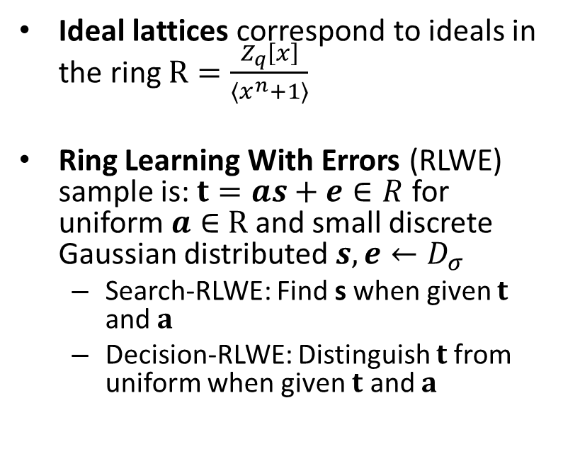
Ring Learning with Errors
$$a$$
random
Ideal lattices correspond to ideals in the ring $R=\frac{Z_{q}\left[x\right]}{\left\langle x^{n}+1\right\rangle }$
Ring Learning With Errors (RLWE) sample is: $t=as+e∈R$ for uniform $a∈$ $R$ and small discrete Gaussian distributed $s,e←D_{σ}$
Search-RLWE: Find s when given $t$ and $a$
Decision-RLWE: Distinguish $t$from uniform when given $t$ and $a$
34 | 23 | … | 23
$$×$$
$$s$$
1 | -2 | … | 0
small secret
(Gaussian)
$$+$$
$$e$$
0 | 1 | … | 0
small error
(Gaussian)
$$=$$
32 | 43 | … | 12
random
$n$ $∼$256 to 1024

Slide 12
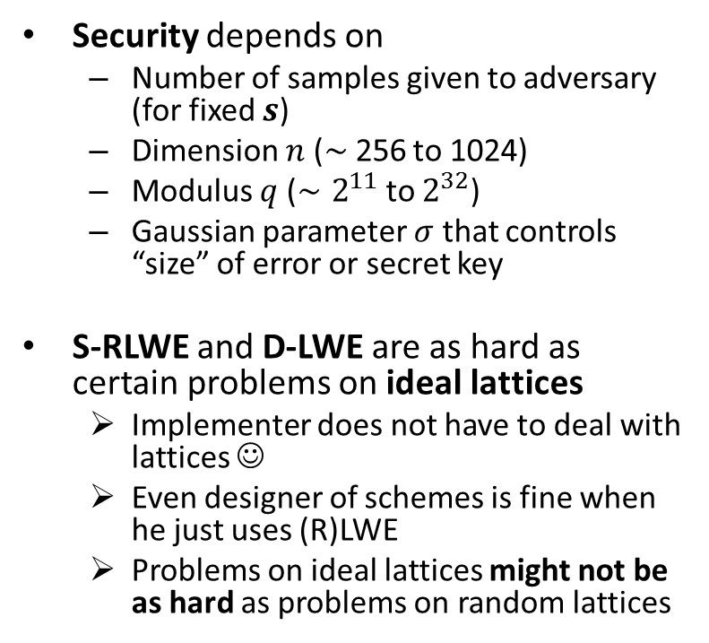
Ring Learning with Errors
$$a$$
random
Security depends on
Number of samples given to adversary (for fixed $s$)
Dimension $n$ ($∼$256 to 1024)
Modulus $q$ ($∼2^{11}$ to $2^{32}$)
Gaussian parameter $σ$ that controls “size” of error or secret key
S-RLWE and D-LWE are as hard as certain problems on ideal lattices
Implementer does not have to deal with lattices ☺
Even designer of schemes is fine when he just uses (R)LWE
Problems on ideal lattices might not be as hard as problems on random lattices
34 | 23 | … | 23
$$×$$
$$s$$
1 | -2 | … | 0
small secret
(Gaussian)
$$+$$
$$e$$
0 | 1 | … | 0
small error
(Gaussian)
$$=$$
32 | 43 | … | 12
random
$n$ $∼$256 to 1024

Slide 13
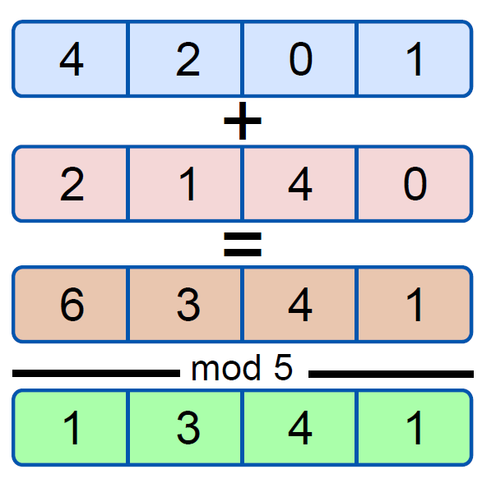




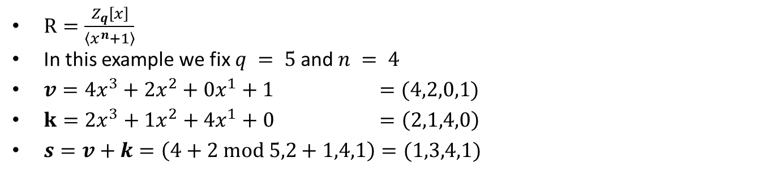
Polynomial Addition in $R=\frac{Z_{q}\left[x\right]}{\left\langle x^{n}+1\right\rangle }$
$R=\frac{Z_{q}\left[x\right]}{\left\langle x^{n}+1\right\rangle }$
In this example we fix $q = 5$and $n = 4$
$v=4x^{3}+2x^{2}+0x^{1}+1 =(4,2,0,1)$
$k=2x^{3}+1x^{2}+4x^{1}+0 =\left(2,1,4,0\right)$
$s=v+k=\left(4+2 mod 5,2+1,4,1\right)=(1,3,4,1)$
$$v$$
$$k$$
$$s$$

Slide 14
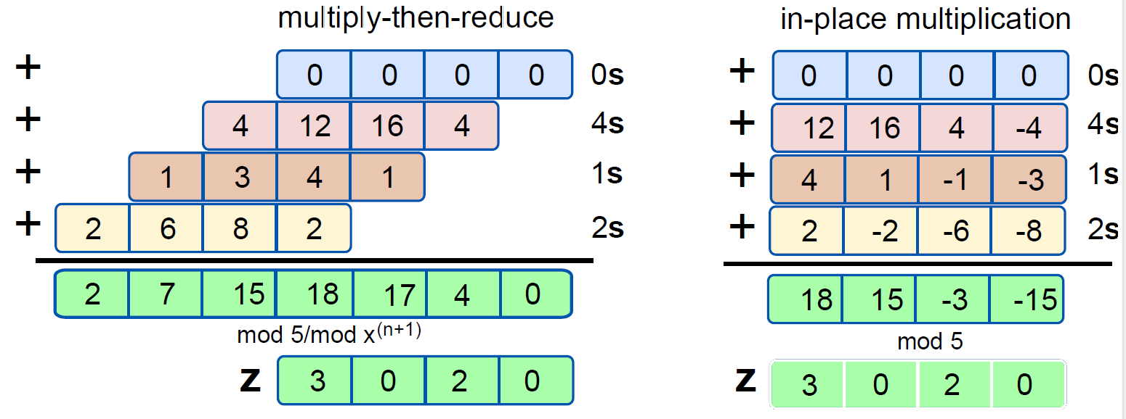

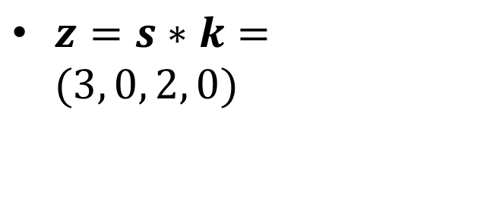
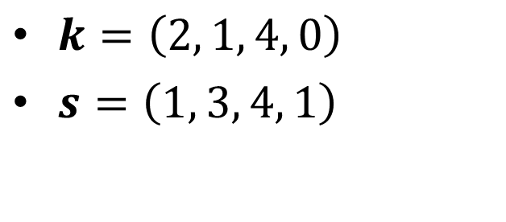
Polynomial Multiplication in $R=\frac{Z_{q}\left[x\right]}{\left\langle x^{n}+1\right\rangle }$
$k=\left(2, 1, 4, 0\right)$
$s=\left(1, 3, 4, 1\right)$
$z=s∗k=(3, 0, 2, 0)$

Slide 15
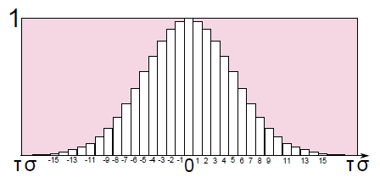
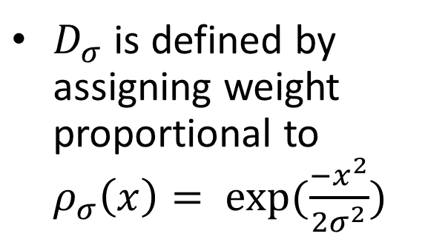


Discrete Gaussian Distribution
$D_{σ}$ is defined by assigning weight proportional to $ρ_{σ}\left(x\right)= exp(\frac{−x^{2}}{2σ^{2}})$
Uniform
-1501 | 1020 | 502 | … | -1900 | 572
$$a$$
$$R=\frac{Z_{4093}\left[x\right]}{\left\langle x^{256}+1\right\rangle }$$
Gaussian
-1 | 4 | -8 | … | 0 | 1
e
Uniform * Gaussian = Uniform
Gaussian * Gaussian = larger Gaussian

Slide 16
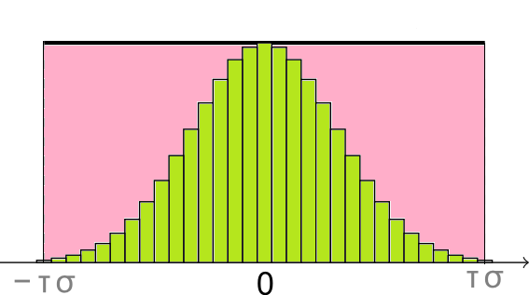
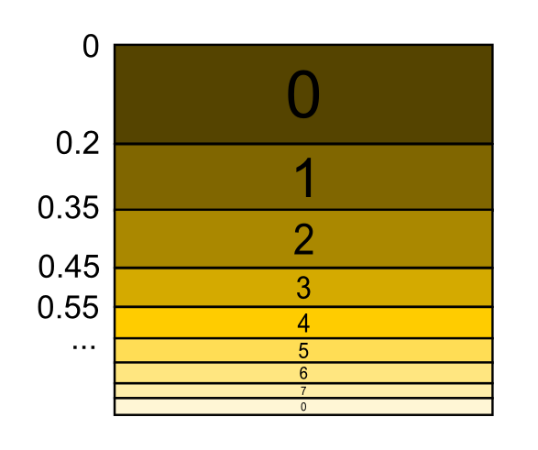
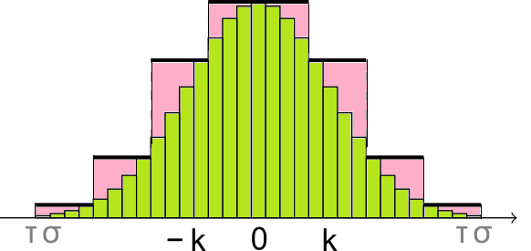
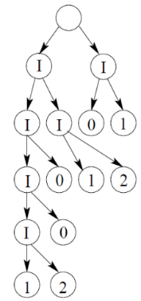
Gaussian Sampling: Options
Rejection Sampling
Cumulative Distribution Table (CDT)
Sampling
Bernoulli Sampling
[DG14] Efficient sampling from discrete Gaussians for lattice-based cryptography on a constrained device, Dwarakanath and Galbraith, Applicable Algebra in Engineering, Communication and Computing, 2014
[DDLL14] Lattice Signatures and Bimodal Gaussians, Léo Ducas and Alain Durmus and Tancrède Lepoint and Vadim Lyubashevsky, CRYPTO '13
Knuth-Yao Sampling

Slide 17
Outline
Motivation
Ring-learning with errors (RLWE)
Public-key encryption based on RLWE
Area-optimized implementation
High-performance implementation

Slide 18



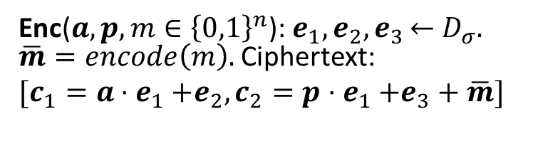




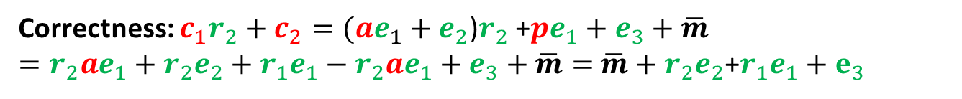







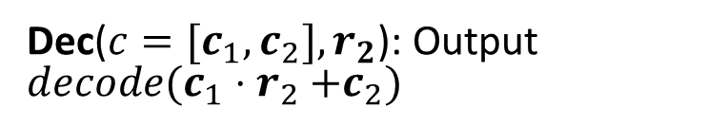
Ring-LWE Encryption: Scheme [LP11/LPR10]
Gen: Choose $a←$ $R and r_{1}$, $r_{2}←$ $D_{σ};$ pk: $p=r_{1}−a{⋅r}_{2}∈R$; sk:$r_{2}$
$$a$$
x
+
$$c_{1}$$
Enc($a,p, m∈{\left\{0,1\right\}}^{n}$):${ e}_{1},e_{2},e_{3}$ $←$ $D_{σ}.$ $\overline{m}=encode\left(m\right).$ Ciphertext:
$[c_{1}=a$ ${⋅e}_{1}+e_{2}, c_{2}=p$ ${⋅e}_{1}+e_{3}+\overline{m}]$
$$D_{σ}$$
$$D_{σ}$$
$$D_{σ}$$
$$p$$
x
+
+
$$c_{2}$$
$$m$$
$$encode$$
Dec(${c=[c}_{1},c_{2}], r_{2}$): Output $decode(c_{1}{⋅r}_{2}+c_{2})$
$$c_{1}$$
$$decode$$
$$m$$
x
+
$$r_{1}$$
$$c_{2}$$
Correctness: $c_{1}r_{2}+c_{2}=(ae_{1}+e_{2}$)$r_{2}$ +$pe_{1}+e_{3}+\overline{m}$
$=r_{2}ae_{1}+{r_{2}e}_{2}+r_{1}e_{1}−r_{2}ae_{1}+e_{3}+\overline{m}=$ $\overline{m}+{r_{2}e}_{2}$+$r_{1}e_{1}+e_{3}$
large
small

Slide 19

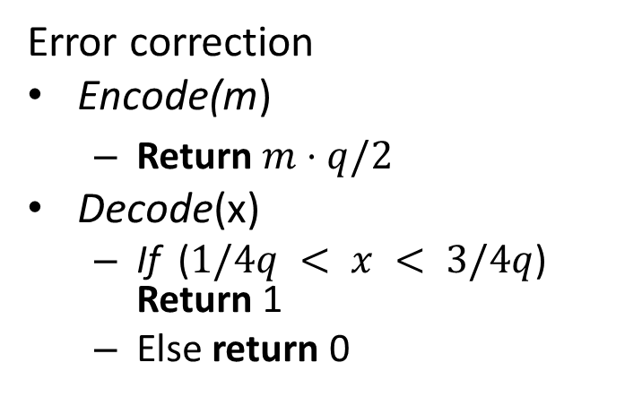






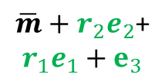
Ring-LWE Encryption: Parameters
Error correction
Encode(m)
Return $m⋅q/2$
Decode(x)
If ($1/4q < x < 3/4q$) Return 1
Else return 0
$$R=\frac{Z_{4093}\left[x\right]}{\left\langle x^{256}+1\right\rangle }$$
$n−$bit message/coefficients
$$m$$
0 | 1 | … | 1 | 0
$$encode\left(m\right)$$
$$\overline{m}$$
0 | 2046 | … | 2046 | 0
$$\overline{m}+{r_{2}e}_{2}\text{+}$$
$$r_{1}e_{1}+e_{3}$$
402 | 1907 | … | 2631 | 4024
de$code\left(m\right)$
$$\overline{m}$$
0 | 1 | … | 1 | 0

Slide 20
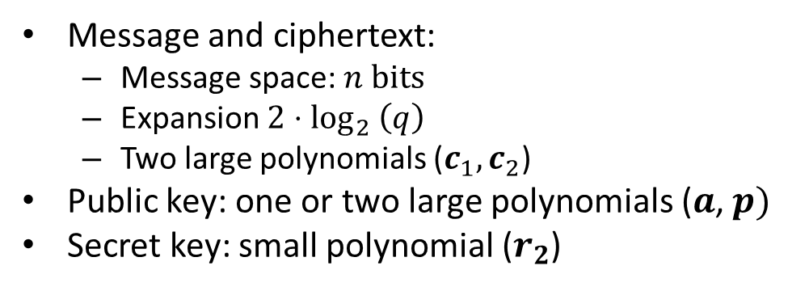
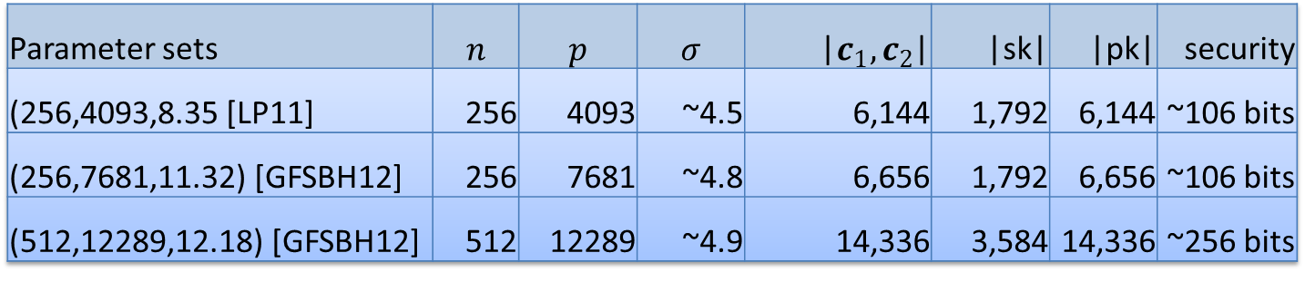
Ring-LWE Encryption: Parameters
Parameter sets | $$n$$ | $$p$$ | $$σ$$ | |$c_{1},c_{2}$| | |sk| | |pk| | security
(256,4093,8.35 [LP11] | 256 | 4093 | ~4.5 | 6,144 | 1,792 | 6,144 | ~106 bits
(256,7681,11.32) [GFSBH12] | 256 | 7681 | ~4.8 | 6,656 | 1,792 | 6,656 | ~106 bits
(512,12289,12.18) [GFSBH12] | 512 | 12289 | ~4.9 | 14,336 | 3,584 | 14,336 | ~256 bits
Message and ciphertext:
Message space: $n$ bits
Expansion $2{⋅log}_{2}\left(q\right)$
Two large polynomials ($c_{1},c_{2}$)
Public key: one or two large polynomials ($a$, $p)$
Secret key: small polynomial ($r_{2}$)

Slide 21
Outline
Motivation
Ring-learning with errors (RLWE)
Public-key encryption based on RLWE
Area-optimized implementation
High-performance implementation

Slide 22
Simple Implementation of RLWE-Encryption
void encrypt(poly a, poly p, unsigned char * plaintext, poly c1, poly c2)
{
int i,j; poly e1,e2,e3;
gauss_poly(e1); gauss_poly(e2); gauss_poly(e3);
poly_init(c1, 0, n); // init with 0
poly_init(c2, 0, n); // init with 0
for(i = 0;i < n; i++){ // multiplication loops
for(j = 0; j<n; j++){
c1[(i + j) % n] = modq(c1[(i + j) % n] + (a[i] * e1[j] * (i+j>=n ? -1 : 1)));
c2[(i + j) % n] = modq(c2[(i + j) % n] + (p[i] * e1[j] * (i+j>=n ? -1 : 1)));
}
c1[i] = modq(c1[i] + e2[i]);
c2[i] = (plaintext[i>>3] & (1<<(i%8))) ? modq(c2[i] + e3[i] + q/2) : modq(c2[i] + e3[i]);
}
}
This has to be fast
Code will be made available: https://www.sha.rub.de/research/projects/lattice/

Slide 23
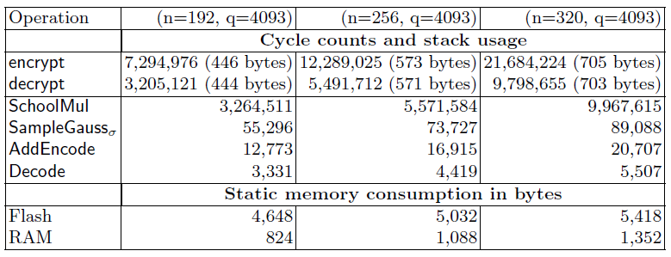
Results in Software
Implementation of RLWE-Encryption on the AVR 8-bit ATxmega processor running with 32 MHz
Schoolbook multiplication (SchoolMul)
Encryption is two multiplications and decryption one

Slide 24
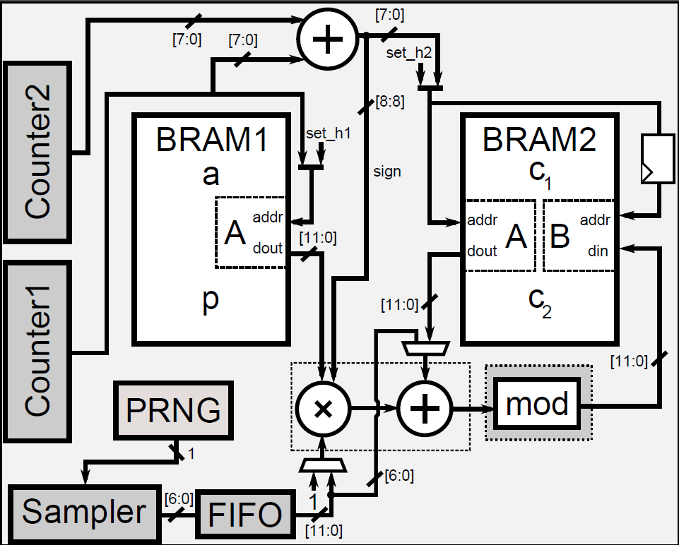
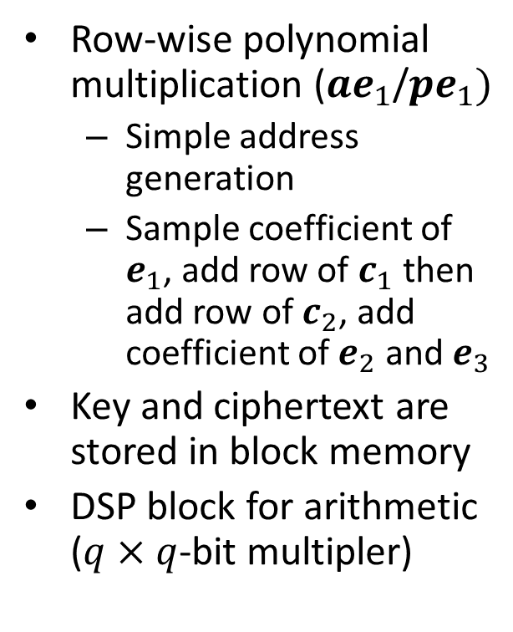
Hardware Implementation: Low Area
We can’t do much about the RAMs
Row-wise polynomial multiplication ($ae_{1}$/$pe_{1})$
Simple address generation
Sample coefficient of $e_{1}$, add row of $c_{1}$ then add row of $c_{2}$, add coefficient of $e_{2}$ and $e_{3}$
Key and ciphertext are stored in block memory
DSP block for arithmetic ($q×q$-bit multipler)
Modular reduction (power ot two possible)
Multiplication (DSP)

Slide 25
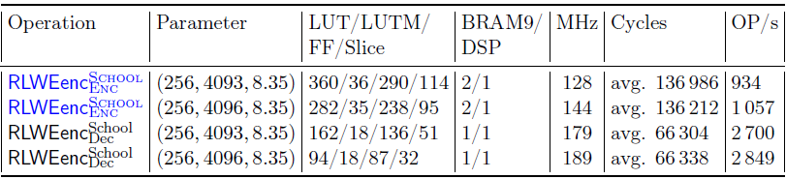
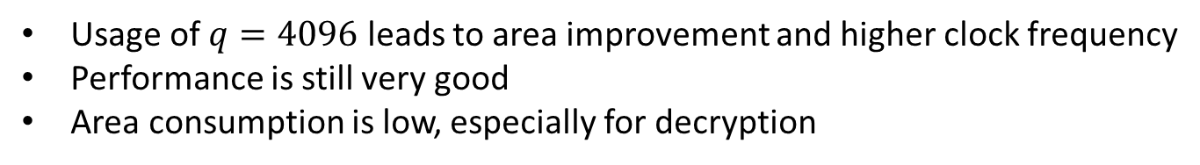
Hardware Implementation: Low Area
Post-place-and-route performance on a Spartan-6 LX9 FPGA.
Area savings by power of two modulus
Usage of $q=4096$ leads to area improvement and higher clock frequency
Performance is still very good
Area consumption is low, especially for decryption

Slide 26
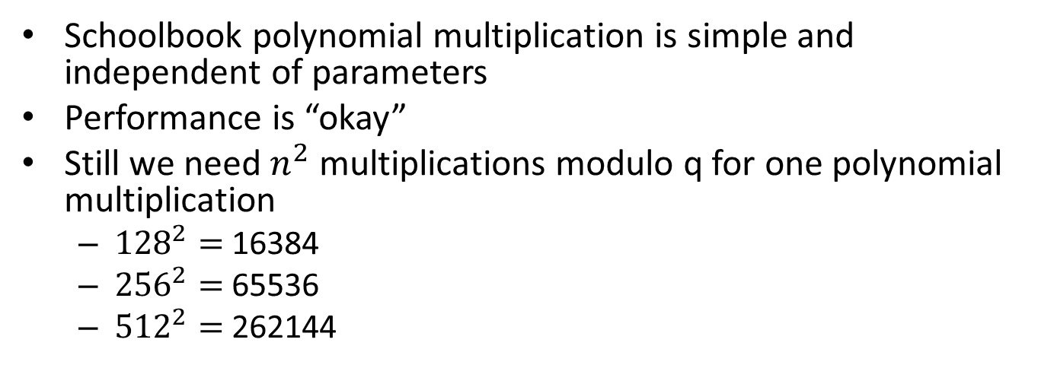
Ring-LWE: Can we do better?
Schoolbook polynomial multiplication is simple and independent of parameters
Performance is “okay”
Still we need $n^{2}$ multiplications modulo q for one polynomial multiplication
${128}^{2}=$16384
${256}^{2}=$65536
${512}^{2}=$262144
Can we do better?

Slide 27
Outline
Motivation
Ring-learning with errors (RLWE)
Public-key encryption based on RLWE
Area-optimized implementation
High-performance implementation
The number theoretic transform (NTT)
Usage of the NTT for lattice-based crypto
Optimization of the NTT

Slide 28
Outline
Motivation
Ring-learning with errors (RLWE)
Public-key encryption based on RLWE
Area-optimized implementation
High-performance implementation
The number theoretic transform (NTT)
Usage of the NTT for lattice-based crypto
Optimization of the NTT

Slide 29

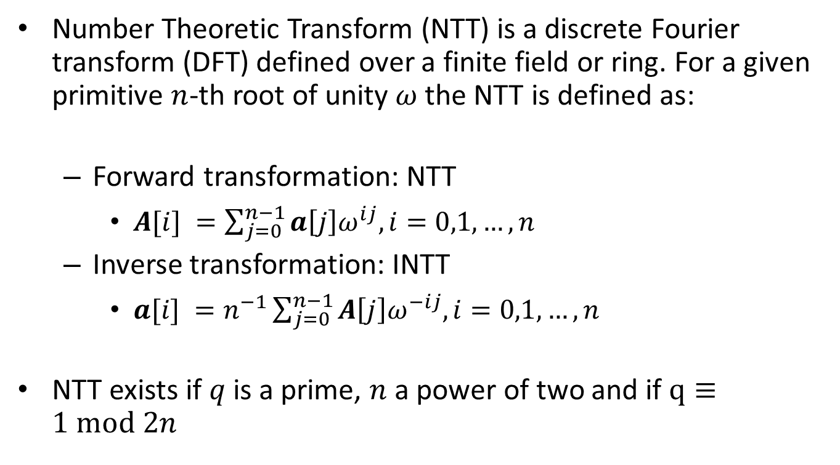
Polynomial Multiplication Using the NTT
Number Theoretic Transform (NTT) is a discrete Fourier transform (DFT) defined over a finite field or ring. For a given primitive $n$-th root of unity $ω$ the NTT is defined as:
Forward transformation: NTT
$A[i] =\sum_{j=0}^{n−1}{a\left[j\right]ω^{ij}, i=0,1,…,n}$
Inverse transformation: INTT
$a[i] =n^{−1}\sum_{j=0}^{n−1}{A\left[j\right]ω^{−ij}, i=0,1,…,n}$
NTT exists if $q$ is a prime, $n$ a power of two and if $q≡1 mod 2n$
Ring-LWE encryption: $7681 mod 2∙256=1$

Slide 30



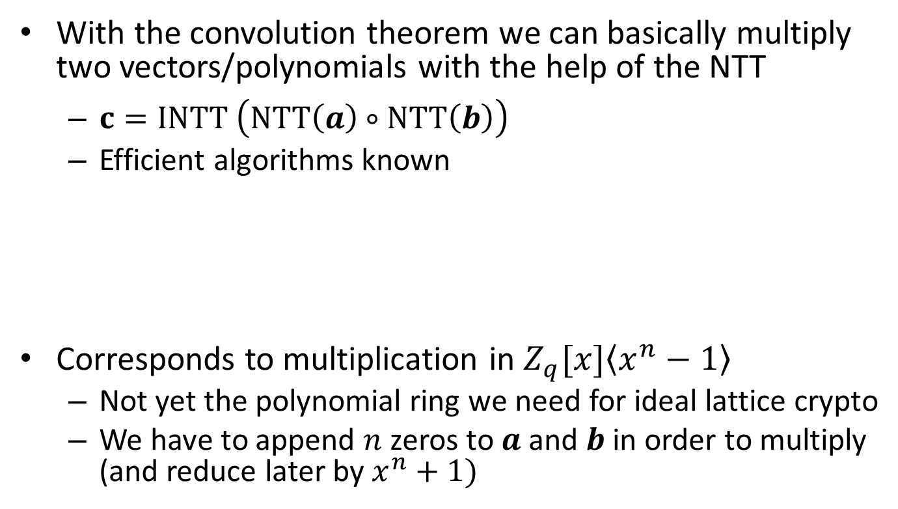



NTT for Lattice Crypto/Convolution Theorem
With the convolution theorem we can basically multiply two vectors/polynomials with the help of the NTT
$c=INTT \left(NTT\left(a\right)∘NTT\left(b\right)\right)$
Efficient algorithms known
Corresponds to multiplication in $Z_{q}[x]\left\langle x^{n}−1\right\rangle$
Not yet the polynomial ring we need for ideal lattice crypto
We have to append $n$ zeros to $a$ and $b$ in order to multiply (and reduce later by $x^{n}+1)$
$$a$$
$$NTT$$
$∘$
$$INTT$$
$$c$$
$$b$$
$$NTT$$

Slide 31
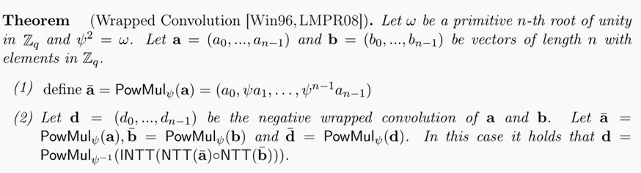
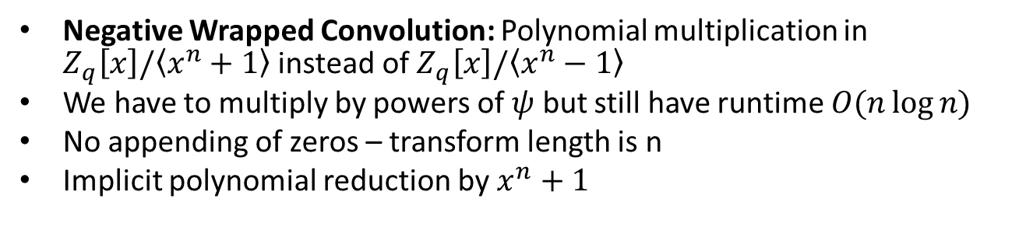
Negative Wrapped/Negacyclic Convolution
Negative Wrapped Convolution: Polynomial multiplication in $Z_{q}\left[x\right]/\left\langle x^{n}+1\right\rangle$ instead of $Z_{q}\left[x\right]/\left\langle x^{n}−1\right\rangle$
We have to multiply by powers of $ψ$ but still have runtime $O(n\log{n)}$
No appending of zeros – transform length is n
Implicit polynomial reduction by $x^{n}+1$

Slide 32
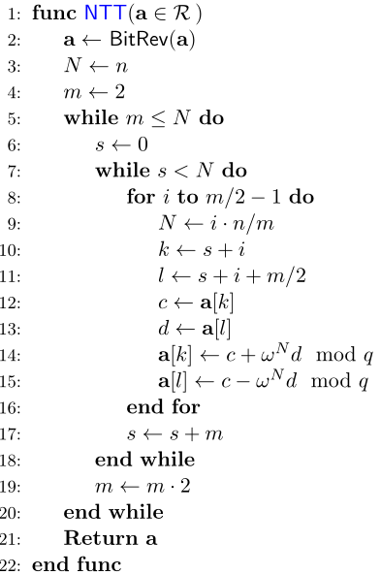
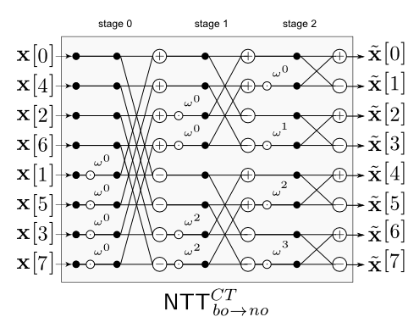

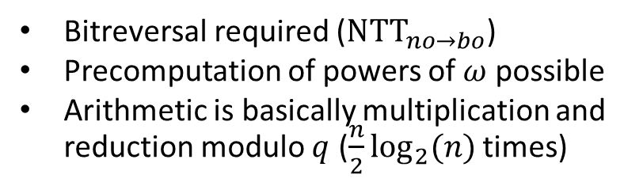
Efficient Computation of the NTT (Textbook)
twiddle factors
Multiplication by $ω^{0}=1$
Bitreversal required (${NTT}_{no→bo}$)
Precomputation of powers of $ω$ possible
Arithmetic is basically multiplication and reduction modulo $q$ ($\frac{n}{2}\log_{2}(n)$ times)

Slide 33
Outline
Motivation
Ring-Learning with errors (RLWE)
Public-key encryption based on RLWE
Area-optimized implementation
High-performance implementation
The number theoretic transform (NTT)
Usage of the NTT for lattice-based crypto
Optimization of the NTT

Slide 34
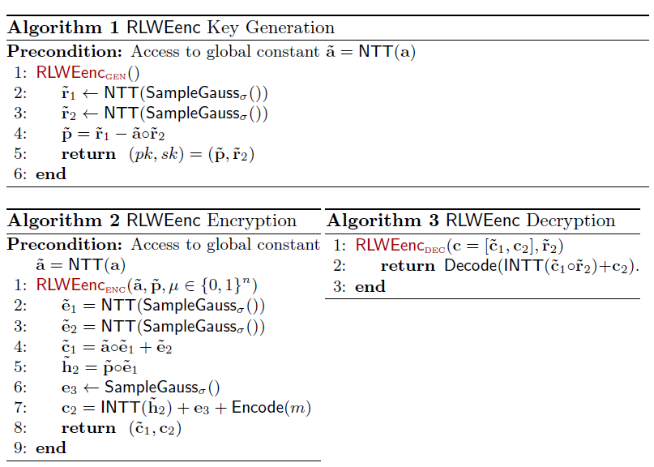
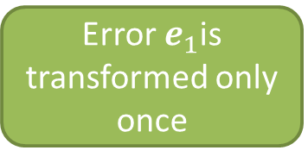
Implementation of Ring-LWE Encryption
Keys are stored in frequency domain
Decryption it just one inverse transformation
Error $e_{1}$is transformed only once

Slide 35
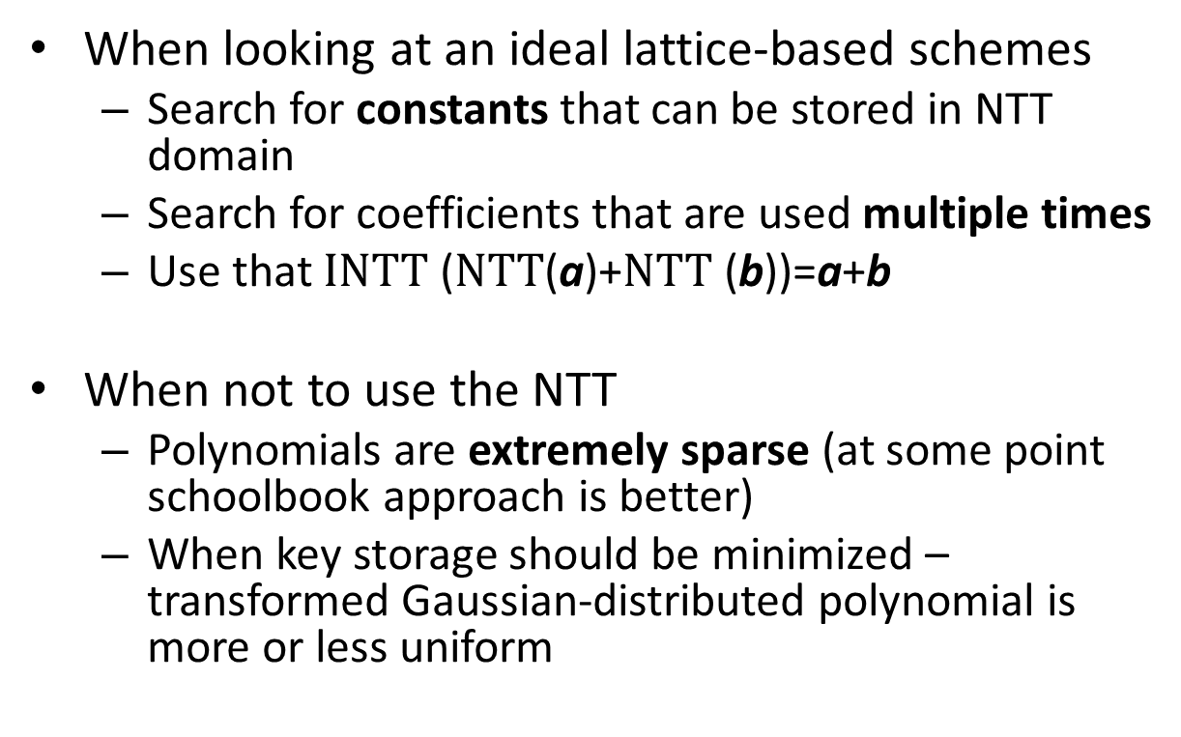
Implementation of Ring-LWE Encryption
When looking at an ideal lattice-based schemes
Search for constants that can be stored in NTT domain
Search for coefficients that are used multiple times
Use that $INTT$ ($NTT$(a)+$NTT$ (b))=a+b
When not to use the NTT
Polynomials are extremely sparse (at some point schoolbook approach is better)
When key storage should be minimized – transformed Gaussian-distributed polynomial is more or less uniform

Slide 36
Outline
Motivation
Ring-Learning with errors (RLWE)
Public-key encryption based on RLWE
Area-optimized Implementation
High-performance implementation
The number theoretic transform (NTT)
Usage of the NTT for lattice-based crypto
Optimization of the NTT

Slide 37
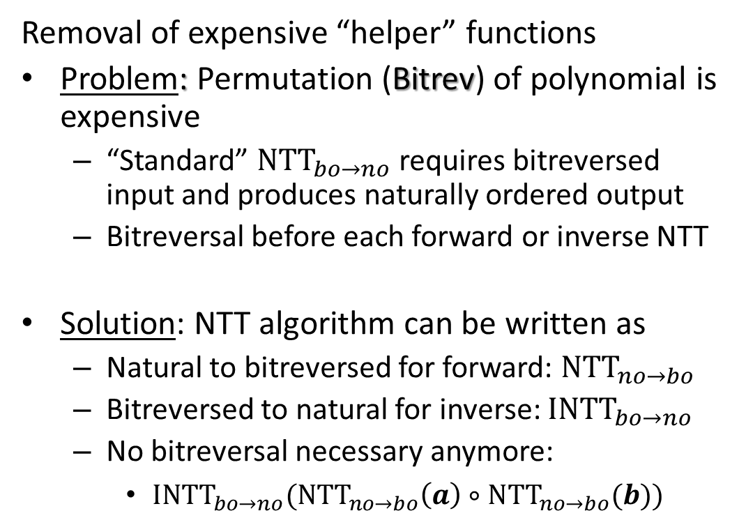
Optimization of NTT Computation
Removal of expensive “helper” functions
Problem: Permutation (Bitrev) of polynomial is expensive
“Standard” ${NTT}_{bo→no}$ requires bitreversed input and produces naturally ordered output
Bitreversal before each forward or inverse NTT
Solution: NTT algorithm can be written as
Natural to bitreversed for forward: ${NTT}_{no→bo}$
Bitreversed to natural for inverse: ${INTT}_{bo→no}$
No bitreversal necessary anymore:
${{INTT}_{bo→no}(NTT}_{no→bo}\left(a\right)∘{NTT}_{no→bo}(b))$

Slide 38
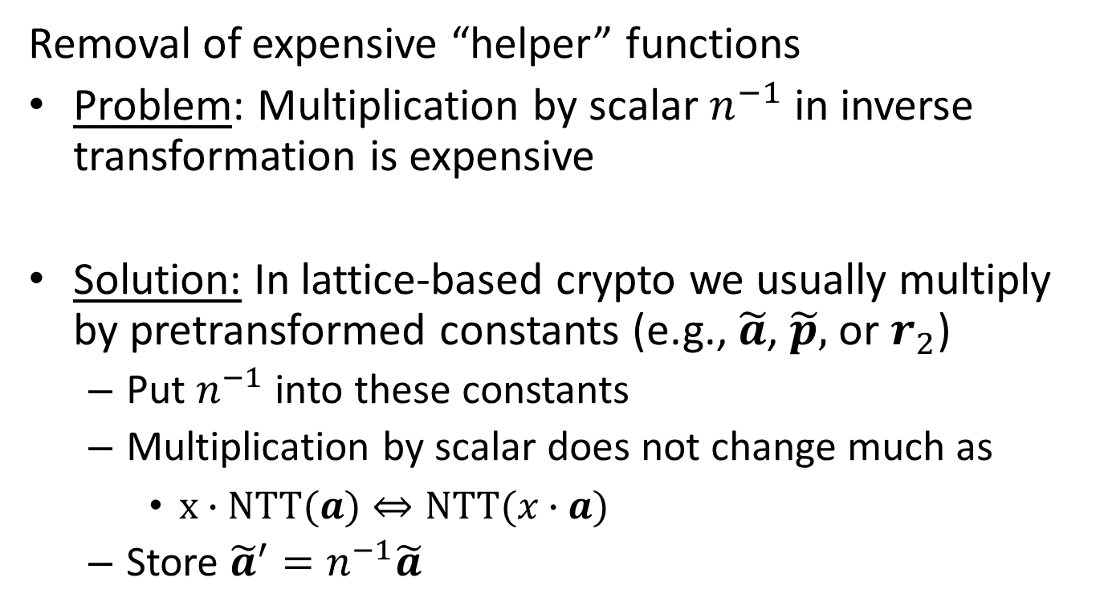
Optimization of NTT Computation
Removal of expensive “helper” functions
Problem: Multiplication by scalar $n^{−1}$ in inverse transformation is expensive
Solution: In lattice-based crypto we usually multiply by pretransformed constants (e.g., $\tilde{a}$, $\tilde{p},$ or $r_{2}$)
Put $n^{−1}$ into these constants
Multiplication by scalar does not change much as
$x∙NTT(a)⇔NTT(x∙a)$
Store ${\tilde{a}}^{′}=n^{−1}\tilde{a}$

Slide 39
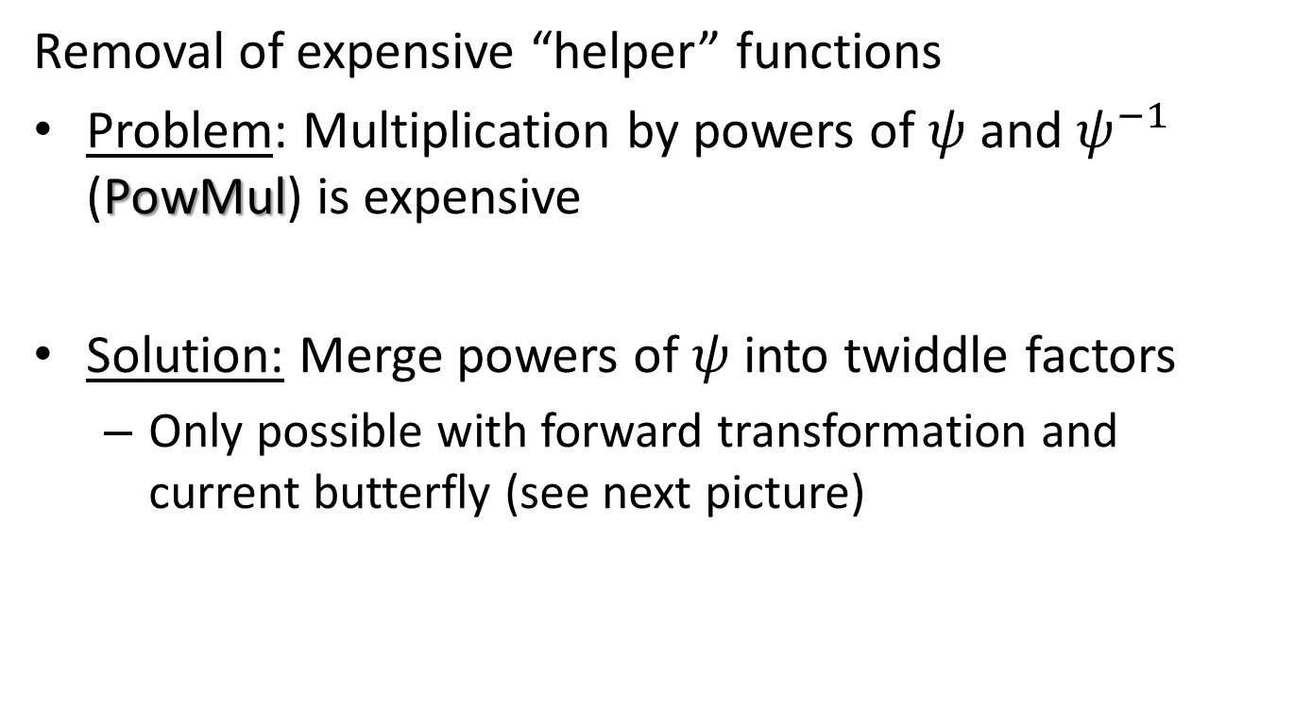
Optimization of NTT Computation
Removal of expensive “helper” functions
Problem: Multiplication by powers of $ψ$ and $ψ^{−1}$ (PowMul) is expensive
Solution: Merge powers of $ψ$ into twiddle factors
Only possible with forward transformation and current butterfly (see next picture)

Slide 40
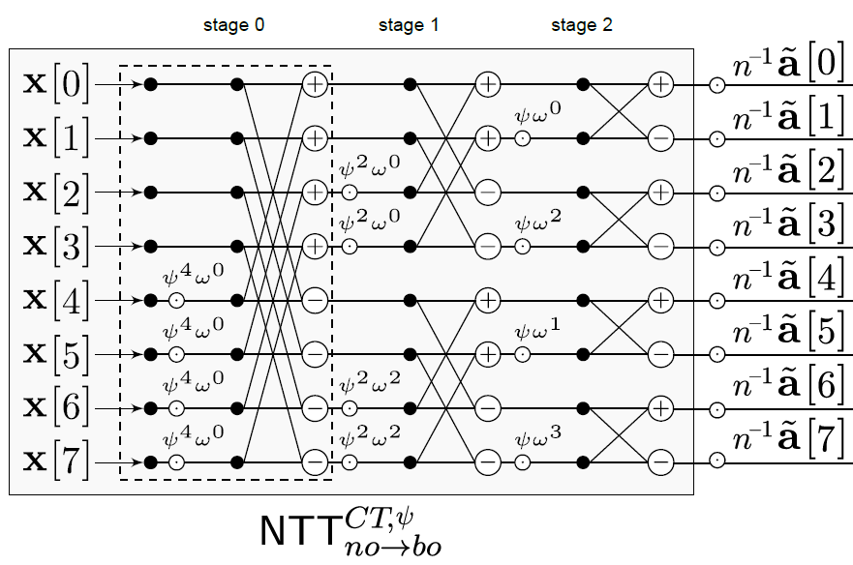
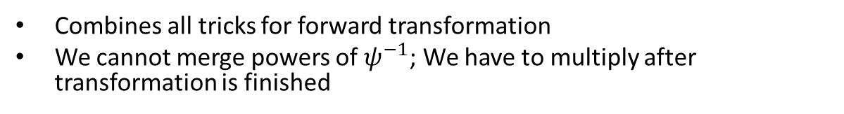
Optimization of NTT Computation
Combines all tricks for forward transformation
We cannot merge powers of $ψ^{−1}$; We have to multiply after transformation is finished

Slide 41


Optimization of NTT Computation
Usage of Gentlemen-Sande (GS) butterfly instead of Cooley-Tukey (CT) allows merging of inverse multiplication by powers of $ψ^{−1}$
CT: $a+ωb$ and $a−ωb$
GS: $a+b$ and ($a−b)ω$
Code will be made available: https://www.sha.rub.de/research/projects/lattice/

Slide 42

Optimization of NTT Computation
textbook
Our work (*)
We save several steps compared to straightforward approach
Almost no additional costs (if we store twiddle factors)
No multiplication by one in first stage anymore
Can be mitigated by using lookup tables if coefficients for e are small
(*) FFT people probably know most of these tricks

Slide 43

Optimization of NTT Computation
How to make the core operation fast
Address generation for NTT is cheap and well researched (see FFT)
The only expensive computation is the butterfly, which boils down to
a $\log_{2}\left(q\right)×\log_{2}\left(q\right)$ multiplication
a $mod q$ modulo reduction
two additions or subtractions modulo $q$
Implementation of the butterfly depends on target architecture
General methods like Montgomery or Barret reduction
Reductions that depend on special primes like Solinas primes

Slide 44

Ring-LWE Encryption on ATXmega
Moderate performance impact of larger parameter set
Very fast decryption
Some pitfalls in practice (only CPA and decryption errors)

Slide 45

Ring-LWE Encryption on ATXmega
Schoolbook was 12 million
Code size is not increased much
Sampler is the bottleneck now
[POG15] High-Performance Ideal Lattice-Based Cryptography on 8-bit ATxmega Microcontrollers,
Thomas Pöppelmann, Tobias Oder, and Tim Güneysu, to appear in Latincrypt’15

Slide 46

Ring-LWE Encryption on FPGA
NTT is very fast but still quite small
Lots of improvement since [GFS+12]

Slide 47
Future Work
Cryptanalysis
Protection against all forms of side channels (timing, power, EM)
Another look at original NTRU
Performance improvements
Talk to signal processing people over the efficient implementation of the NTT
Evaluate more algorithms for polynomial multiplication

Slide 48







Augment Cryptanalysis with Side-Channel
SPA on RSA
small
large
zero
small
SPA on Sampler
(obviously not measured)
$$e_{1}$$
$$e_{2}$$
$$e_{3}$$
$$e_{4}$$
RLWE: You are given (a,$t=as+e$) and you have to find s
Can we recover e or s faster if we have additional information on e (or s)

Slide 49
Implementing Lattice-Based Cryptography on Embedded Devices
Summer school on real-world crypto and privacy
Questions?
Code: https://www.sha.rub.de/research/projects/lattice/
Thanks to Tobias Oder and Tim Güneysu

